Slide 1
Wallace Hall Academy Primary 7 Open Evening

Slide 2
Pupil Programme
Timings | Group 1 | Group 2 | Group 3 | Group 4 | Group 5 | Group 6 | Group 7
6.30-6.50 | PE - Games Hall (Mr Steele and Mr Laverty) | Science A2005 (Mr Evans) | Social Subjects A1012 (Mr Gray) | Art A1031 (Mrs Simpson) | Maths A0006 (Mr Bell) | Design and Technology A0034 (Mr Lees and Mr McKenna) | Music A1018 (Miss Girvan)
6.50-7.10 | Music A1018 (Miss Girvan) | ICT-A2023 (Miss Park) | Science A2005 (Mr Evans) | English A1017 (Mr McClair) | Design and Technology A0034 (Mr Lees and Mr McKenna) | Maths A0006 (Mr Bell) | PE - Games Hall (Mr Steele and Mr Laverty)
7.10-7.30 | Maths A0006 (Mr Bell) | PE - Games Hall (Mr Steele and Mr Laverty) | ICT-A2023 (Miss Park) | Modern Studies A1012 (Mr Gray) | Art A1031 (Mrs Simpson) | Science A2005 (Mr Evans) | English A1017 (Mr McClair)
7.30-7.50 | Design and Technology A0034 (Mr Lees and Mr McKenna) | Music A1018 (Miss Girvan) | Art A1031 (Mrs Simpson) | ICT-A2023 (Miss Park) | English A1017 (Mr McClair) | Social Subjects A1012 (Mr Gray) | Science A2005 (Mr Evans)
7.50-8pm | Canteen | Canteen | Canteen | Canteen | Canteen | Canteen | Canteen

Slide 3
Agenda for the evening
6.35-6.50pm – Mr Graham – Introduction to Wallace Hall
6.50-7.05pm – Mr Blair – Curriculum Structures
7.05-7.30pm – School Tour and Refreshments
7.30-7.55pm – Support for Pupils at Wallace Hall and Transitions

Slide 4
P7 Induction Wallace Hall Academy
1.C1
1.C2
1.N1
1.S1
S1 Class Photographs August 2022

Slide 5
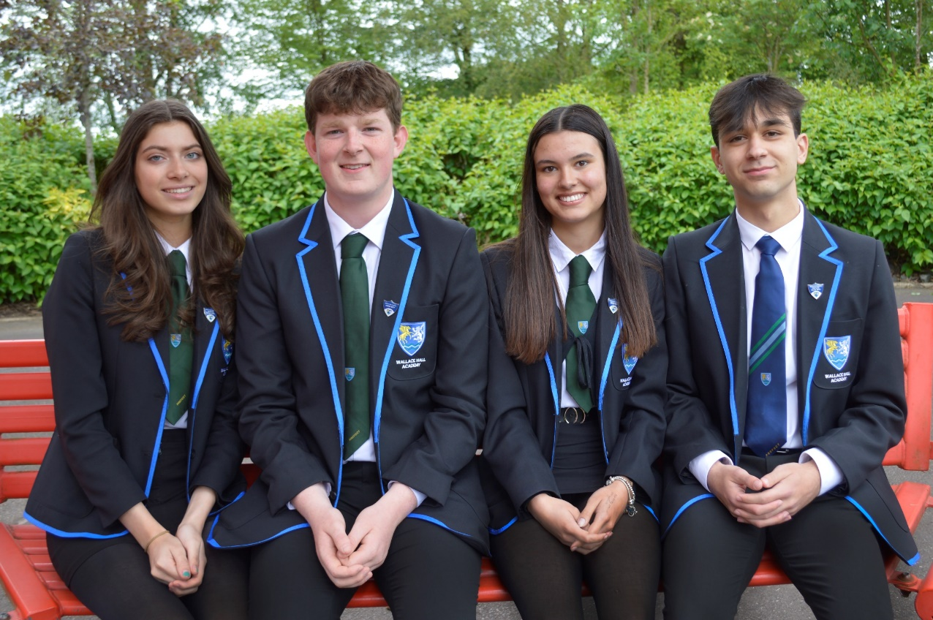
Ethos of the school
Our school motto is “Together we grow, learn and achieve”.
We aim to provide a safe, happy environment where all learners can enjoy the school experience and can be challenged and supported to reach their full potential.
Our 2022 S6 Office Bearers: L - R Jessica Denholm (Depute Head Girl), Fergus Bainbridge (Head Boy), Priya Rome (Head Girl) and Emanuel Kazaki (Depute Head Boy)

Slide 6
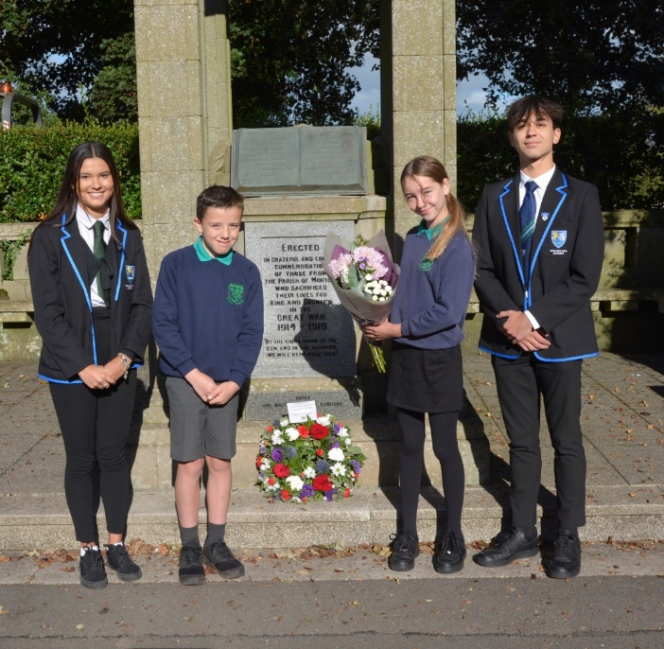
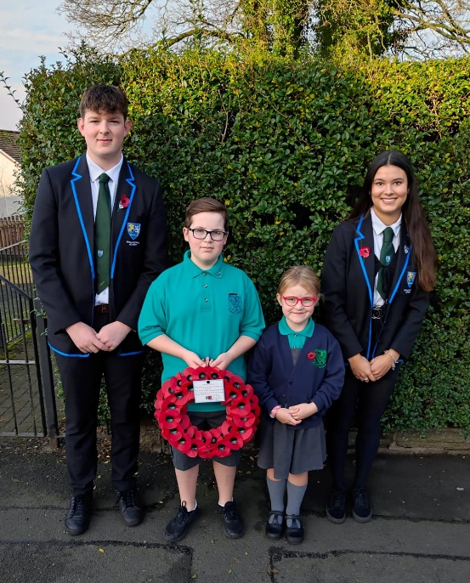
Developing Capacities
At Wallace Hall Academy our students are encouraged to develop the following capacities:
Communication
Compassion
Collaboration
Critical Thinking
Creativity
Composure
Citizenship
Curiosity Ken Robinson
“Creative Schools”
On behalf of the whole community at Wallace Hall, Archie S
and Olivia from P7
and Priya and Emanuel from S6 visited the war memorial in Thornhill to pay our respects to HM Queen Elizabeth II
Fergus, Ben, Mia and Priya represent Wallace Hall at the Remembrance Day Memorial Service

Slide 7
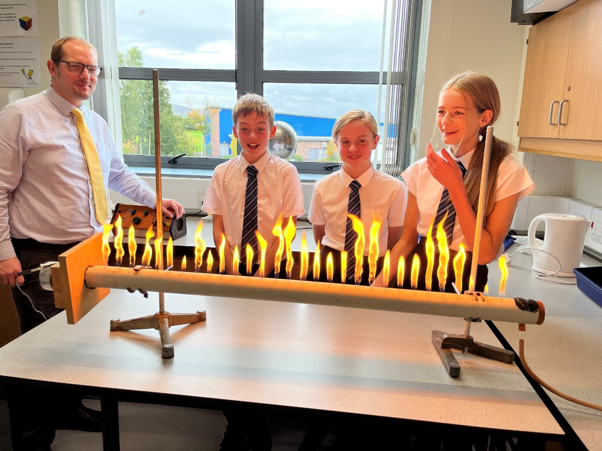
What makes a good school?
If I was a parent what would I want to know about Wallace Hall Academy?
Dr Fulton shows Alfie, Brooke and Lauren what our Ruben’s Tube can do

Slide 8
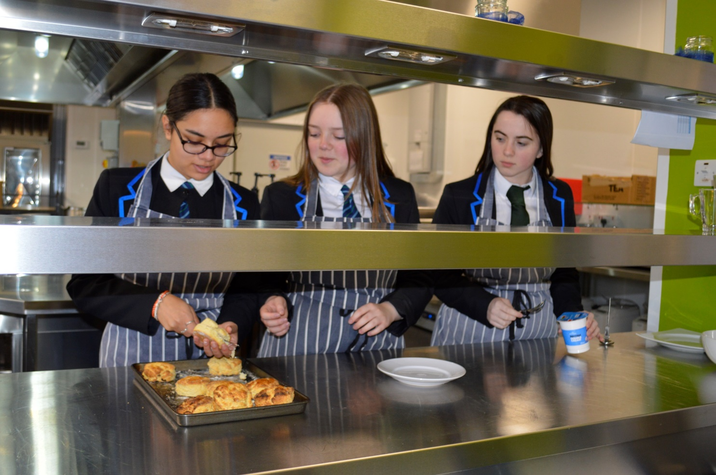
Research tells us that there is no single recipe for a good school but there are major ingredients
Heather, Teri and Olivia preparing cream scones in the Pegasus kitchen

Slide 9
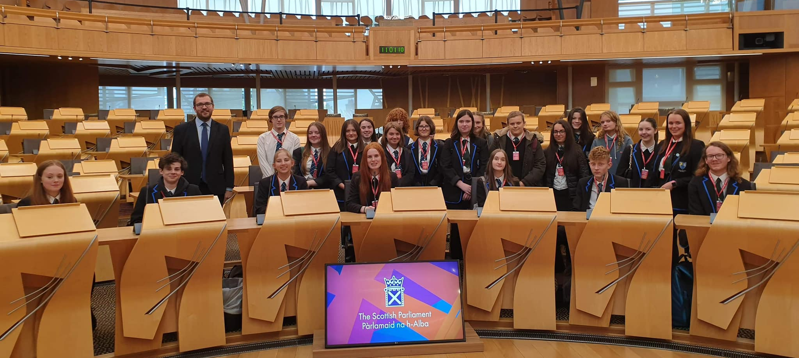
Students enjoy learning - they feel challenged and confident
Our Higher Modern Studies and Higher Politics pupils visited Scottish Parliament recently. They were given a tour of the Parliament by constituency MSP Oliver Mundell and watched First Minsters Questions with Nicola Sturgeon

Slide 10
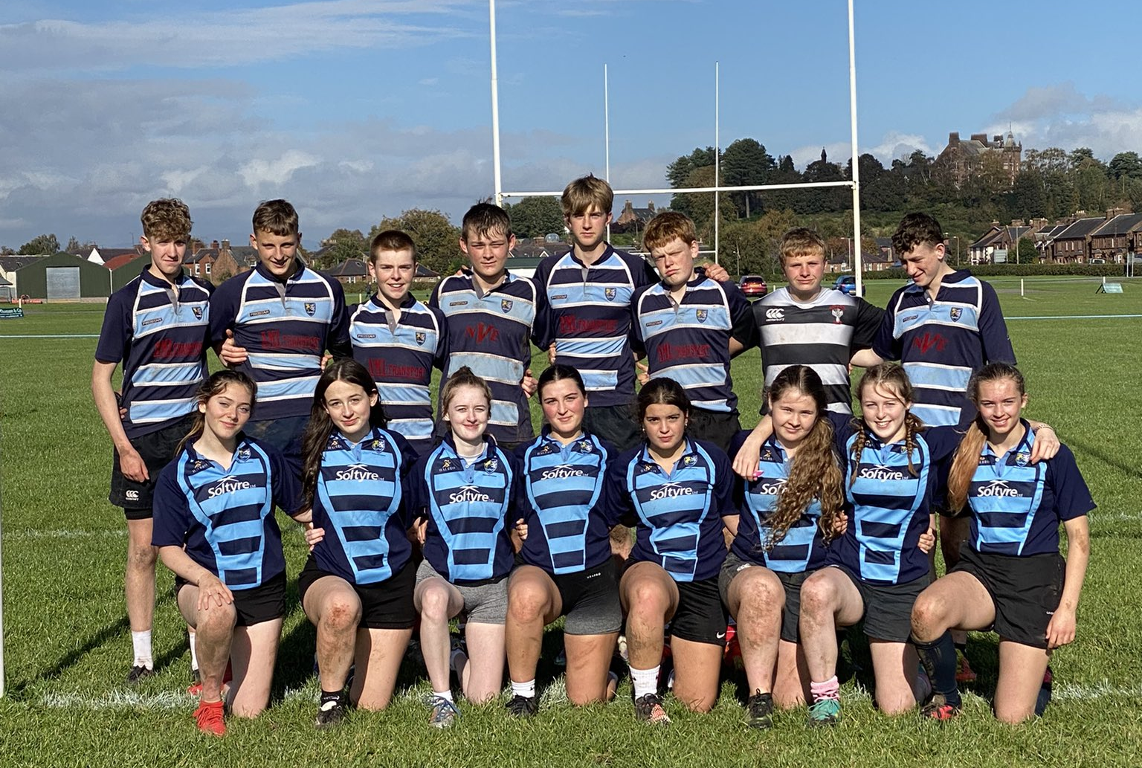
Creative and Expressive Arts and
Sporting Clubs offer opportunities for all
This year’s school show is “Wendy & Peter Pan” and will take place on Monday 19th December, Tuesday 20th December and Wednesday 21st December, starting at 7pm. Tickets can be purchased online by scanning the QR code on the poster
Our U16 rugby squad recently took part in the Dumfries Schools 7s qualifier

Slide 11
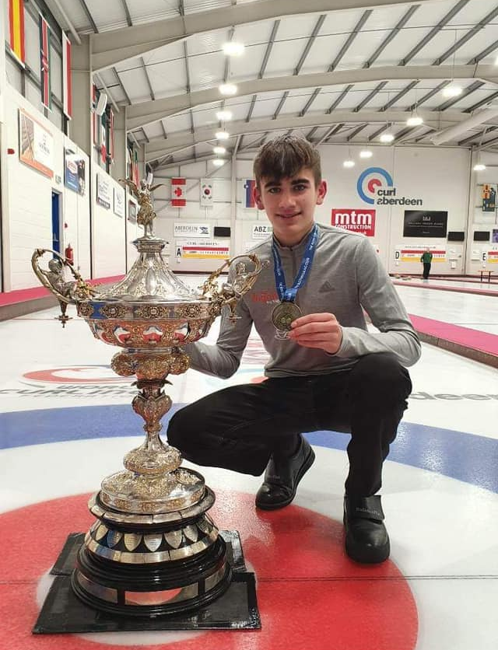
Awards and Achievements
A group of our senior pupils recently completed MVP training. Our newly trained mentors will now be working with junior pupils to promote healthy relationships in our school community
Congratulations to Charlie who recently was crowned Scottish Junior Curling Champion with Team O Carson. Charlie goes on to represent Scotland in the World Junior Curling Championships in February
Lily, Iona and Sophia with their Young Writers Association ‘Talent for Writing’ Certificates

Slide 12
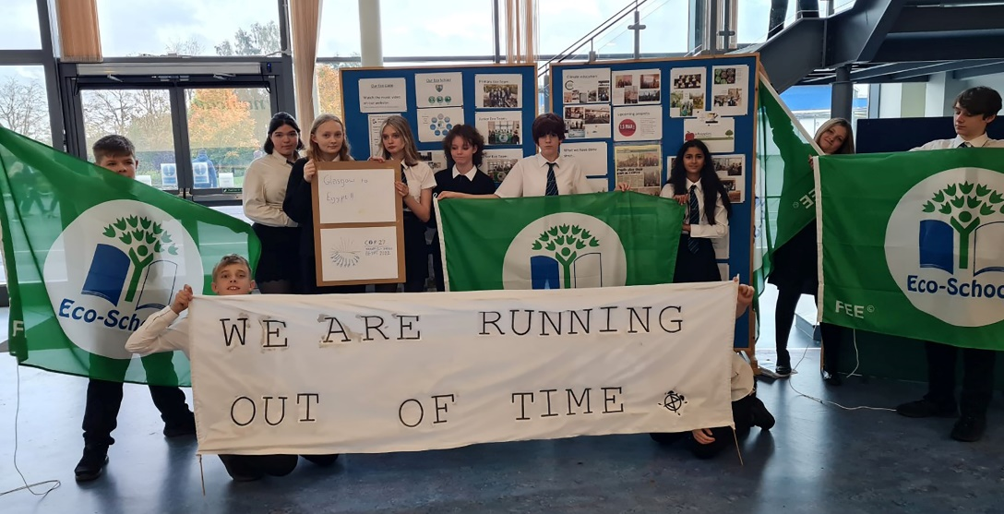
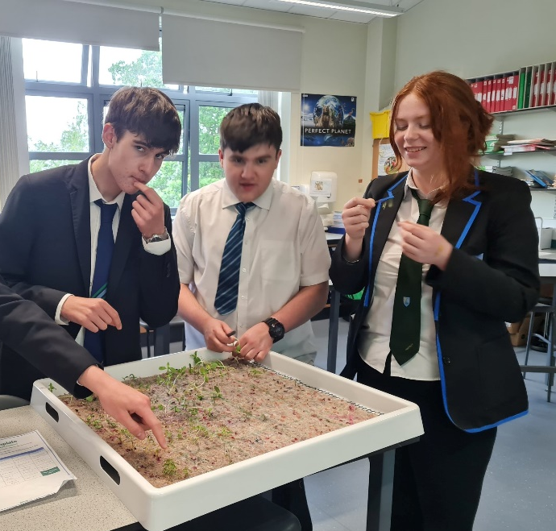
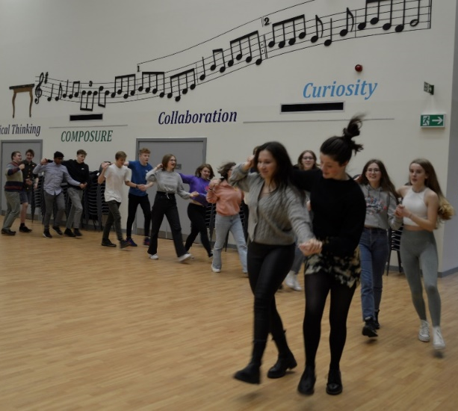
Pupil focus group highlighted:
“The wide variety of choice including electives.”
Vocational courses
Our Eco Group host the baton relay during COP26
Thomas, Callum and Lizzie
look after our Hydroponic Cube
We offer a wide variety of electives including, Activity Tourism, Car/Bike Maintenance, Eco Committee, Fitness, Performance and Development, Food for the Future, Whapples, and Erasmus
Wallace Hall pupils teaching our Erasmus visiting students the art of ceilidh dancing

Slide 13
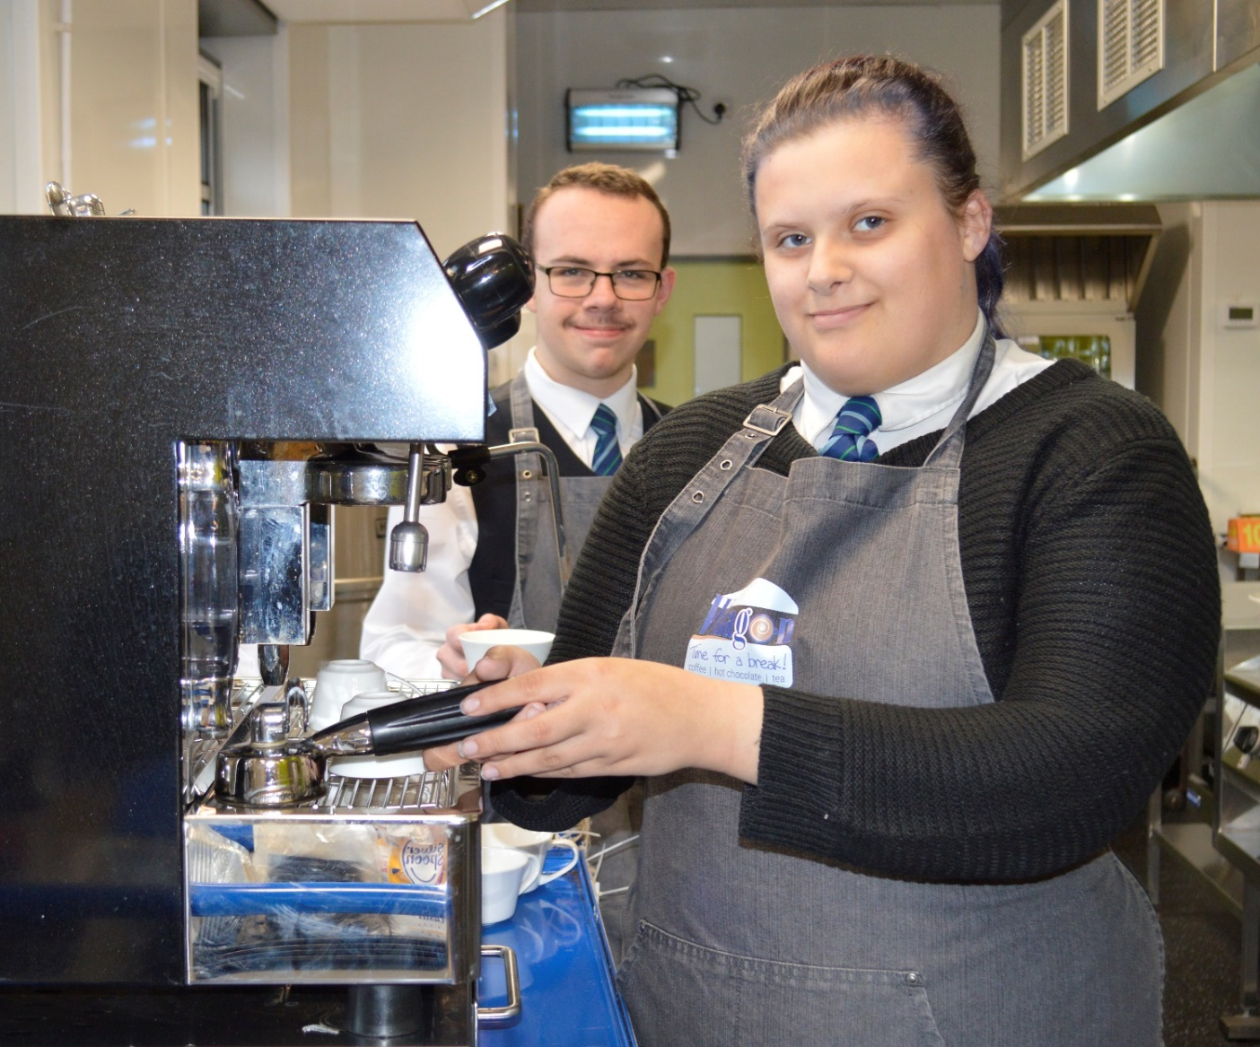
Pupils in our Barista Group learn how to make delicious hot drinks
Hamish and Bryony getting to grips with the Barista coffee machine

Slide 14
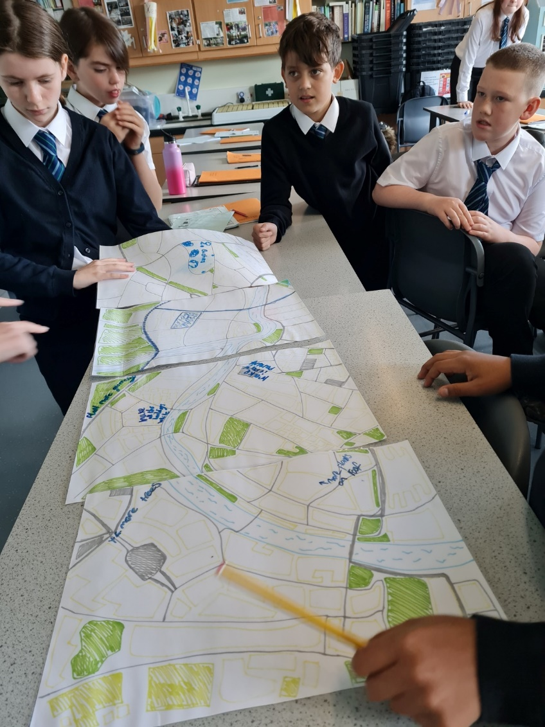
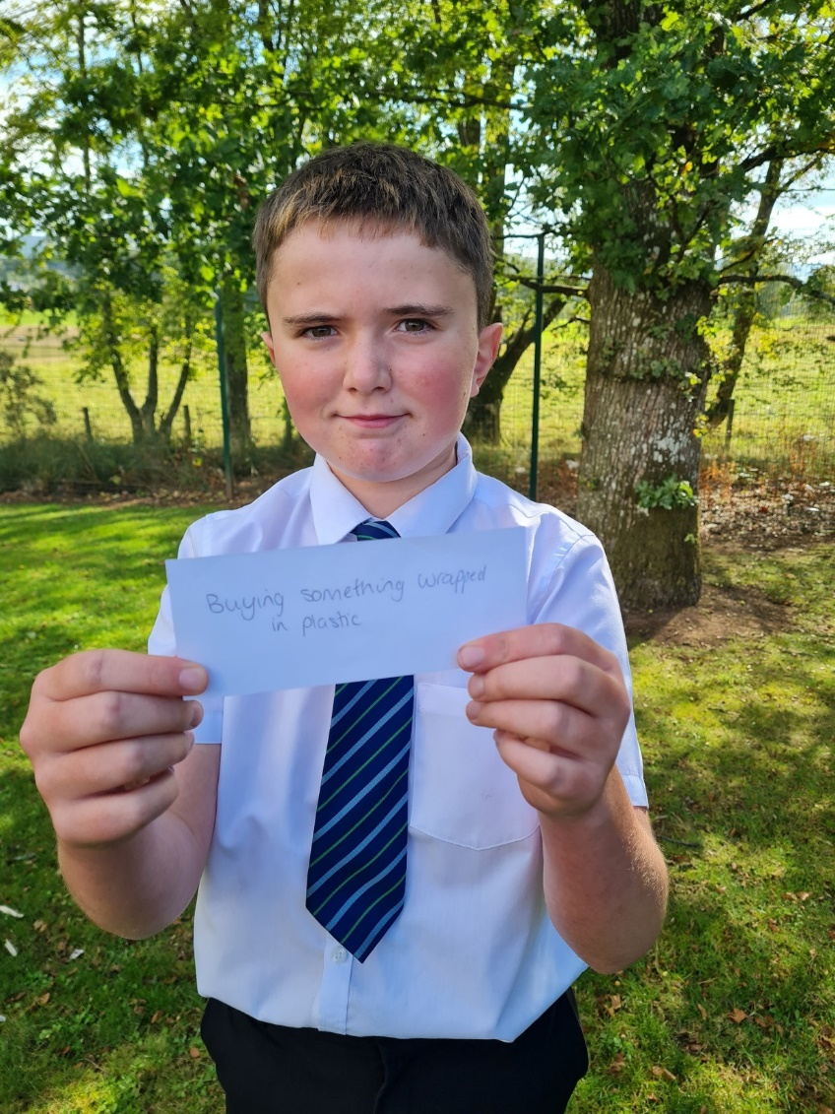
Pupil focus group highlighted:
“The school has a really friendly environment and the staff offer a huge range of activities.”
Some of our S1 pupils work with staff from the Crichton Carbon Centre
to discuss possible actions to address the climate emergency

Slide 15
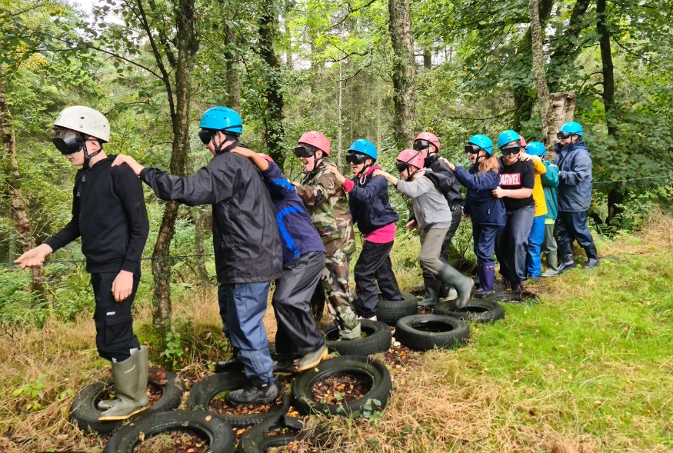
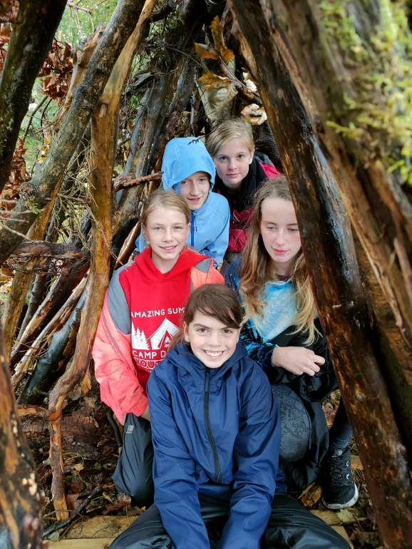
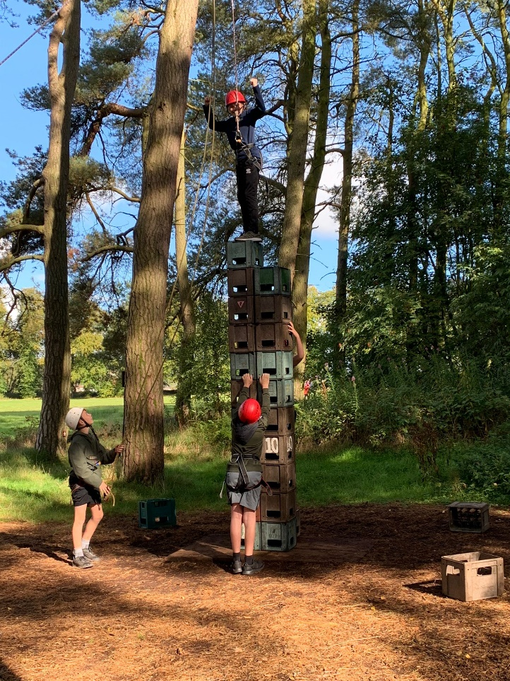
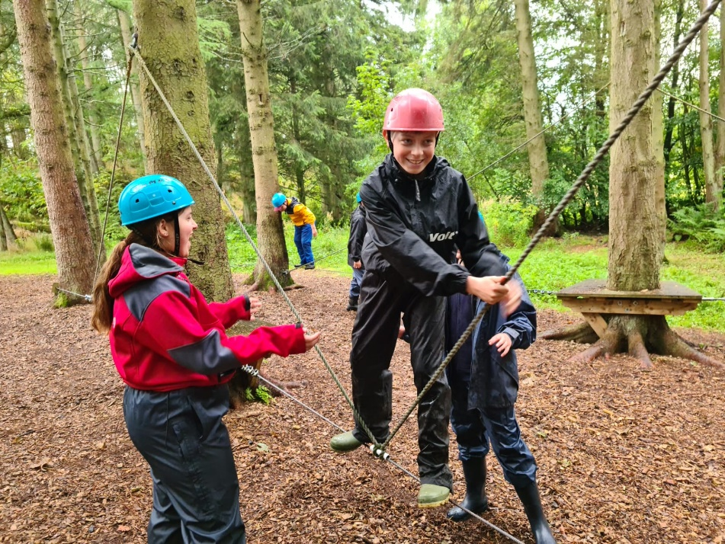
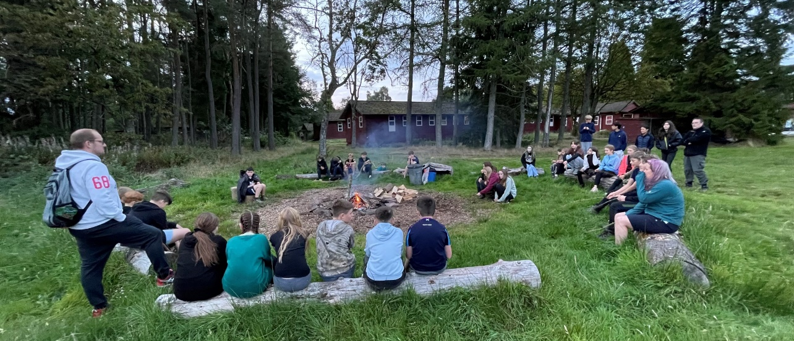
S1 Trip to Broomlea
Our new S1 pupils enjoying their visit to the outdoor education centre at Broomlea

Slide 16
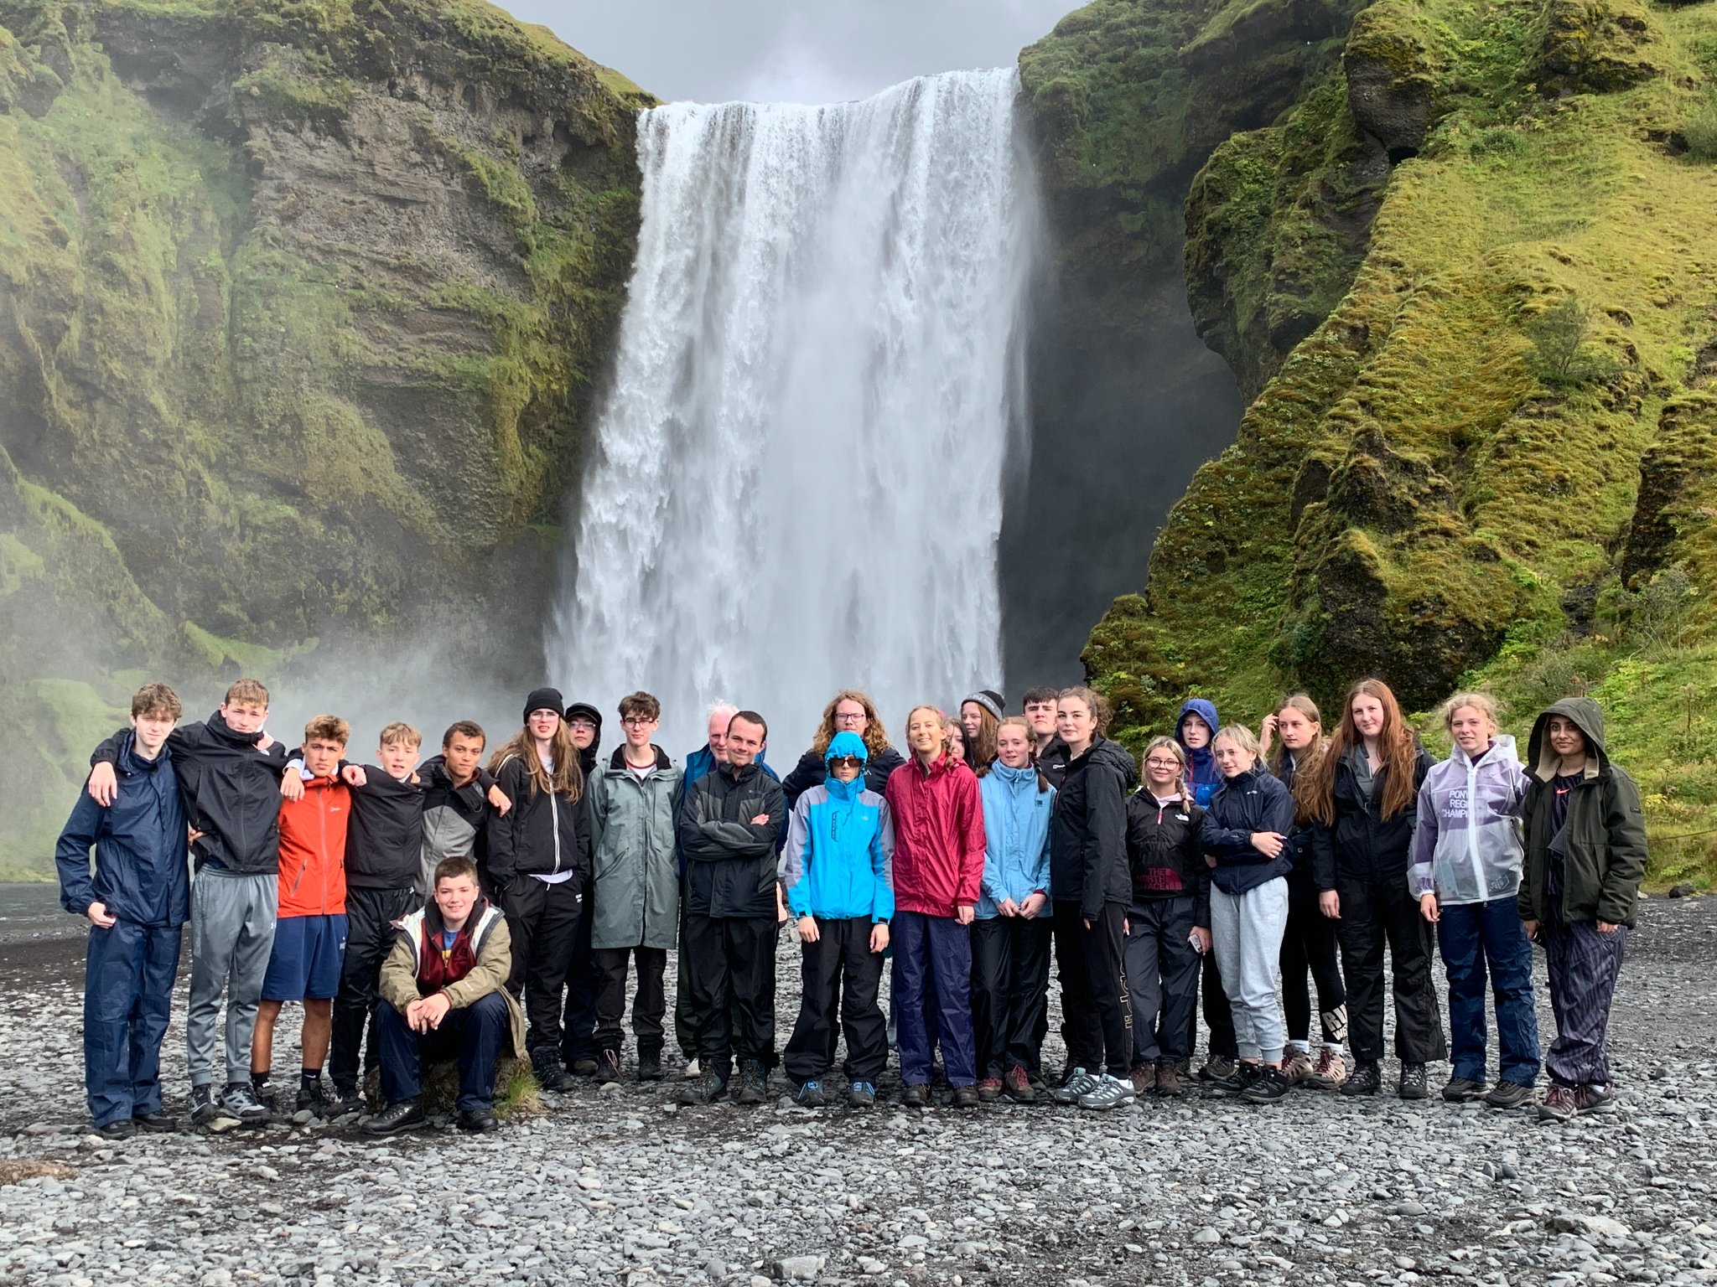
Geography Trip to Iceland
Pupils on the Geography Trip to Iceland in August 2022

Slide 17
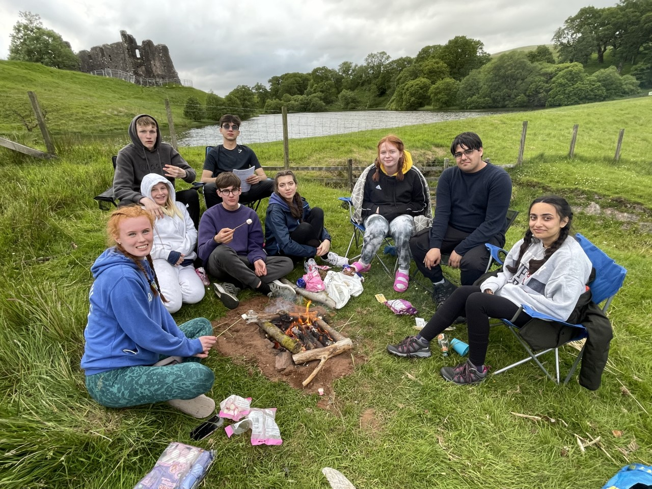
Duke of Edinburgh
Some of our DofE students on their expedition earlier this year

Slide 18
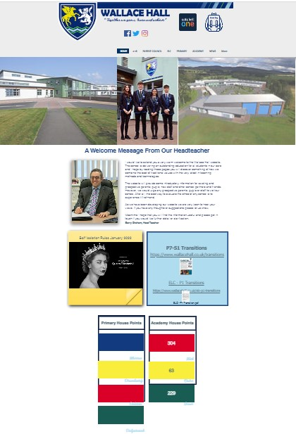
There is good communication between school and parents
Parent Council
Website
Group Call
Letters
Twitter
Instagram
Facebook

Slide 19
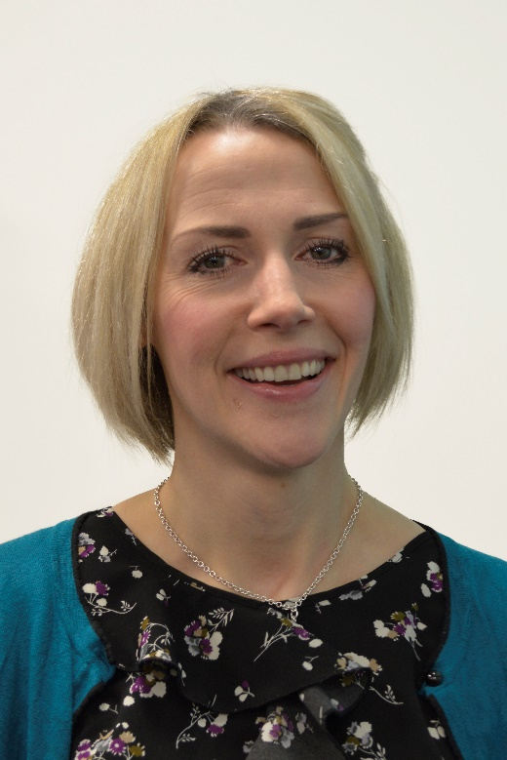
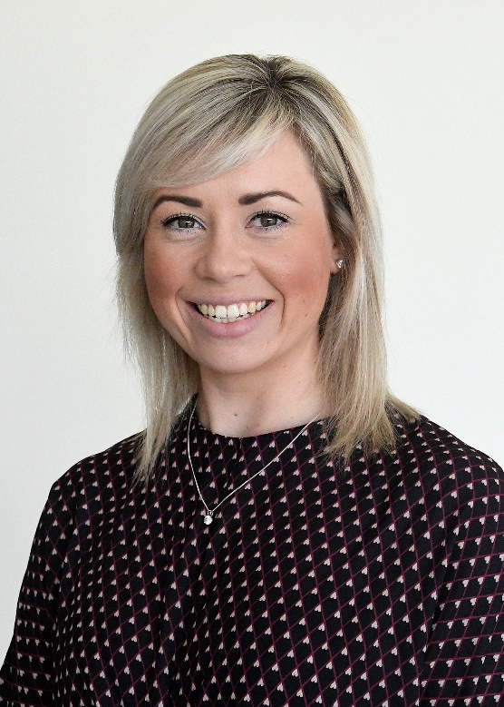
Contacting the school
Mr Mack
Depute Head Teacher
with responsibility for Transitions
Mrs Mack
PT Pupil Support with responsibility for
Transitions
Mrs Flint
PT Additional
Support for Learning
Email: gw08officewallace@ea.dumgal.sch.uk
Telephone: 01848 332120

