Slide 1
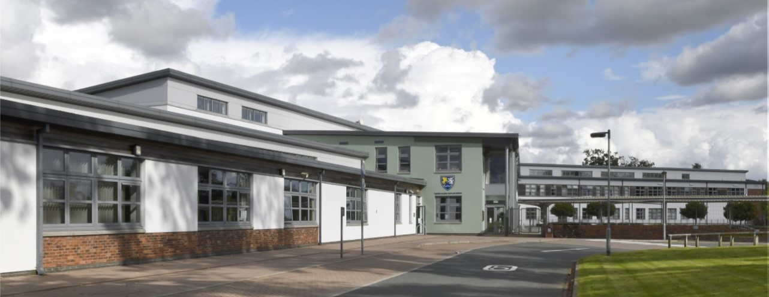
Support for all at Wallace Hall Academy

Slide 2
Health and wellbeing at Wallace hall academy

Slide 3
Pupil Support Team
Mrs Flint
Mrs Fraser
Mrs Robertson
Mrs Mack
PT Additional Support for Learning
PT Pupil Support
PT Pupil Support
PT Pupil Support
Cairn
Nith
Scaur

Slide 4
Learning Support Team

Slide 5
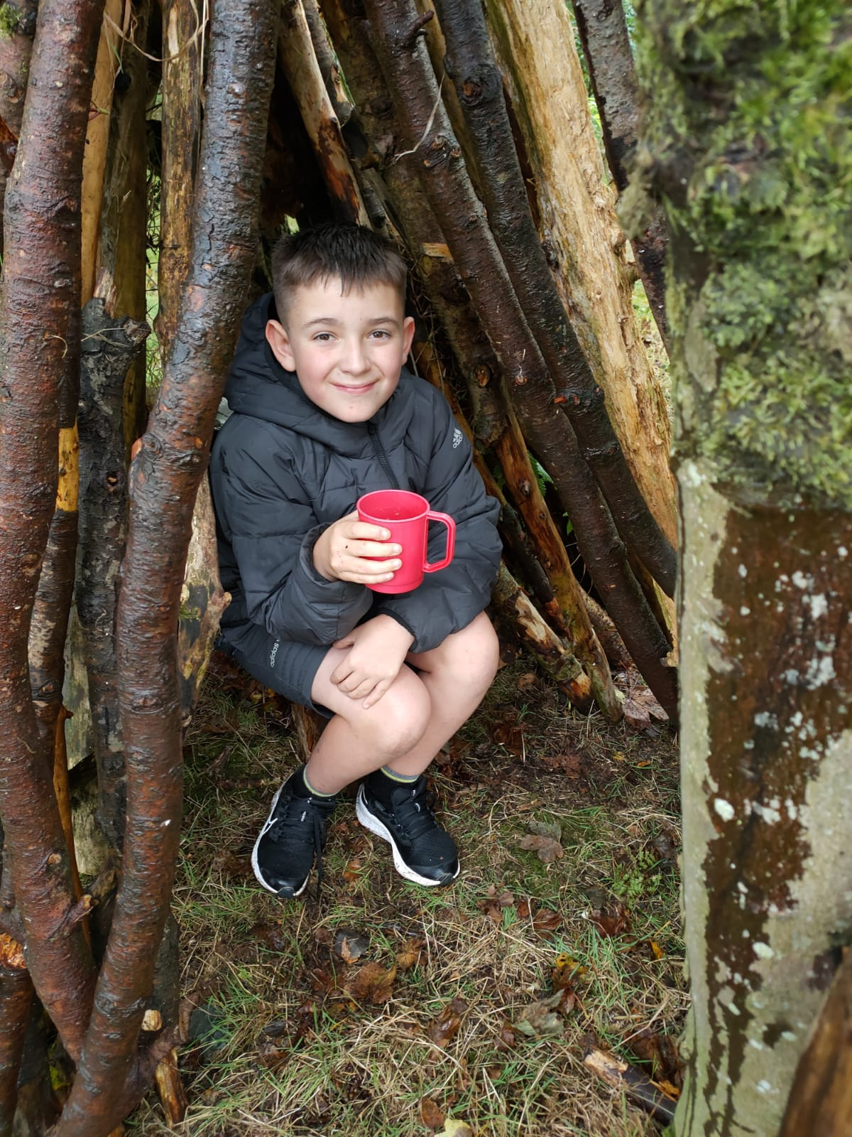
Feeling well
Universal Support
Pupil Support Team
HWB conversation
HWB curriculum
Targeted Support
Nurture group
1:1 LA support
Emotional support for key staff
Multiagency in-school support
Notes:
Breakfast club, Pre order food, HWB curriculum
5

Slide 6
In school Support
School Nurse
Youth Worker
Autism Outreach
School Police Office
Skills Development Scotland

Slide 7
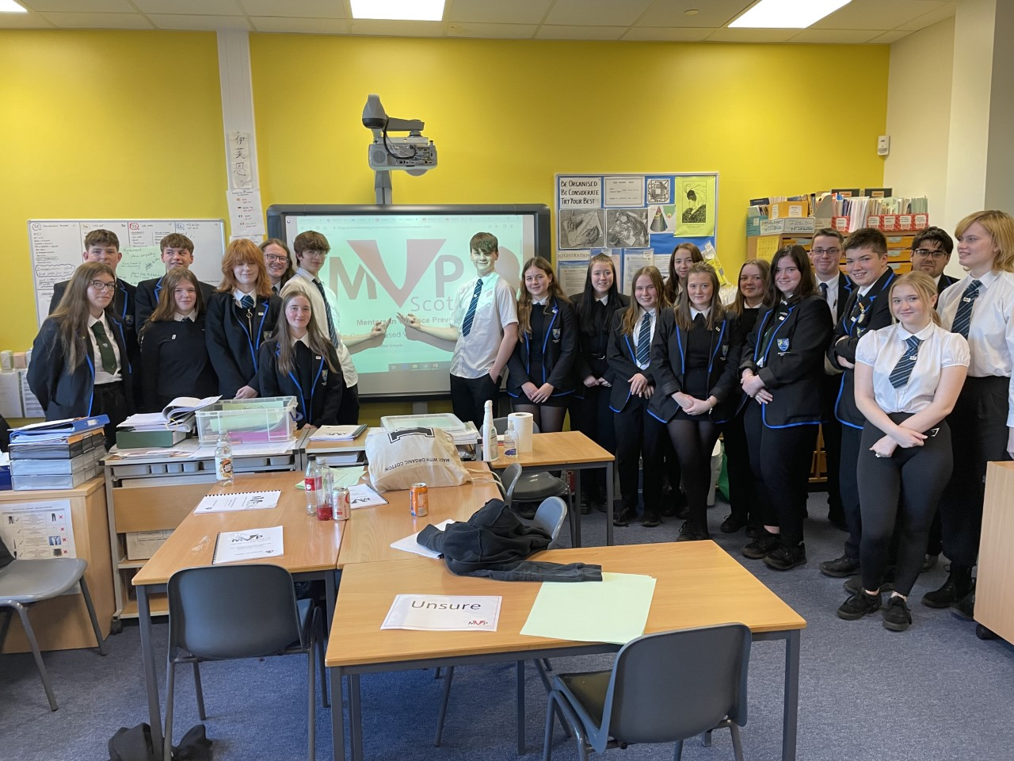
Including well
Universal Support
Pupil Voice
MVP
Information Sharing
Targeted Support
Pupil Info Icon
Learning Support Team
Pupil Equity Funding Team
Multiagency partnerships
Notes:
7

Slide 8
External Support
Educational Psychology
SALT
CAMHS
Social Work
NHS

Slide 9
learning well
Subject | Level | Teacher | Where | Day | Time
Admin & IT | N5/H | Miss Park & Miss Young | A2024 | Thursday | 15:45-16:45
Business Management | N5/H | Miss Park & Miss Young | A2024 | Thursday | 15:45-16:45
Business Management | N5/H | Mrs Fraser | A2016 | Wednesday | 15:45-16:45
Art | N3/4/5 | Mrs Black | A1030 | Wed/Thurs/Fri | Lunchtime
Art | N5/H | Mrs Simpson | A1031 | Wednesday/ Thursday | 15:45-16:45
Biology | N5/H | Mrs Belford | A2010 | Tuesday | 15:45-16:45
Chemistry | N5/H | Mrs Hunter | A2017 | Wednesday | 15:45-16:45
Design & Manufacture | N5 | Mr McKenna | A0024 | Tuesday | 15:45-16:45
Design & Manufacture | H/ADV | Mr Lees | A0034 | Thursday | 15:45-16:45
Drama | N5/H/ADV | Miss Griffin | Drama Studio | Tuesday | 15:45-16:45
Engineering Science | N5/H | Mr Lees | A0034 | Thursday | 15:45-16:45
English | N5 | Mr Pape | A1016 | Wednesday | 15:45-16:45
English | Higher | Mr Pape | A1016 | Thursday | 15:45-16:45
English | N5 (Morgan Poetry Focus) | Mrs Robertson | A1014 | Wednesday | Lunchtime
English | H (RUAE Focus) | Mrs Carson | A1013 | Tuesday | 15:50-16:30
English | N5/H | Mr McClair | A1017 | Thursday | Lunchtime
French | N5/H/AH | Miss Edgar | A2019 | Wednesday | 15:45-16:45
Geography | N5/H | Mr Miller | A2014 | Tuesday | 15:45-16:45
Graphic Communication | N5/H | Mr Corrigan | A0018 | Monday | Lunchtime
History | N5/H | Mr Harley | A1008 | Friday | Lunchtime
History | N5/H | My Gray | A1012 | Tuesday | 15:45-16:45
Maths | H | Mr Bell | A0006 | Friday | 13:15-13:55
Maths / (Applications) | N5 | Miss Stirling | A0005 | Thursday | 13:15-13:55
Maths (Applications) | N5 | Mr Watt | A0007 | Wednesday | 15:45-16:45
Modern Studies | N5/H | Miss Stuart | A1007 | Tuesday | 15:45-16:30
Music | N5/H/ ADV | Miss Girvan | A1018 | Monday (by appointment) | 15:45-16:45
PE | Higher | Mr Steele | SB001 | Tuesday | 15:45-16:45
PE | Higher | Mr Lindsay | SB001 | Friday | 13:15-13:55
Photography | NPA/ Higher | Mrs Simpson | A1031 | Wednesday/ Thursday | 15:45-16:45
Physics | N5/H | Mr Evans | A2005 | Thursday | 15:45-16:45
Politics | Higher | Mr Gray | A1012 | Tuesday | 15:45-16:45
Universal Support
Study Support timetable
Options Interviews
Targeted Support
Differentiation
Study Skills
Alternative timetable
Variety of qualifications
Notes:
9

Slide 10
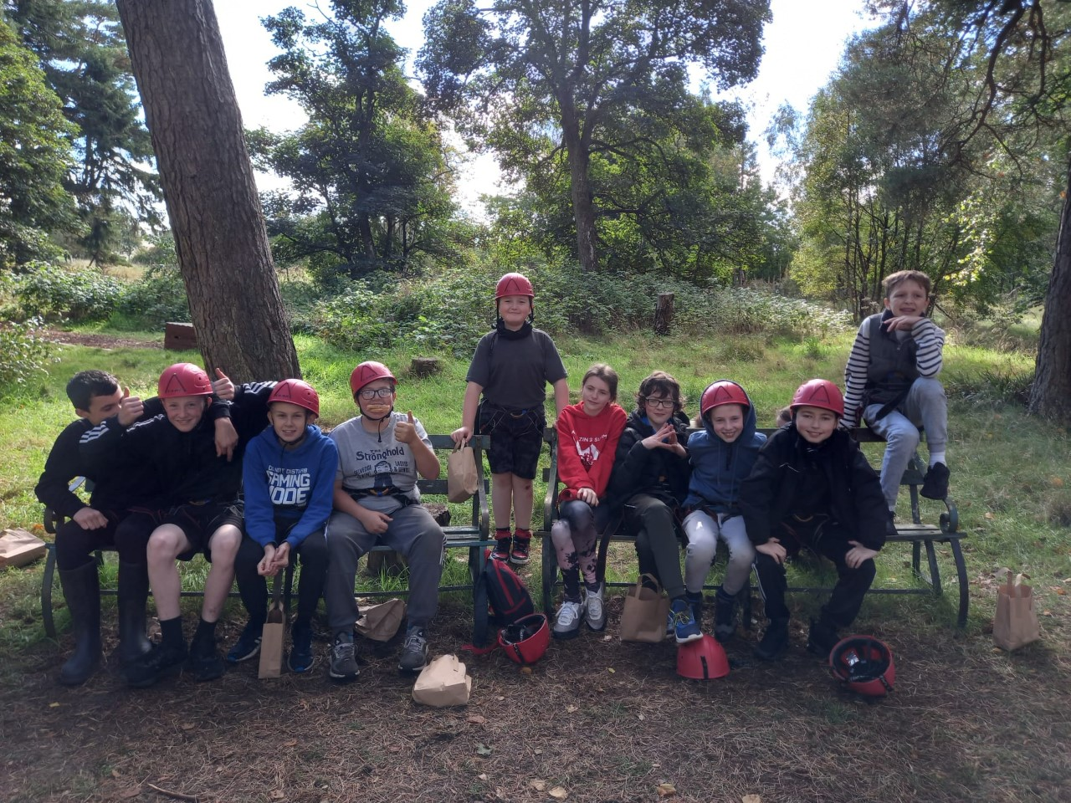
achieving well
Universal Support
Progress and achievement tracking
Wider achievement
HWB conversations
Targeted Support
Mentoring
Literacy and numeracy interventions
Notes:
10

Slide 11
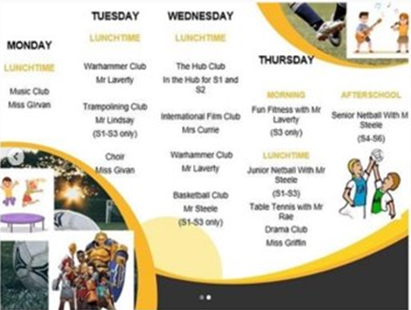
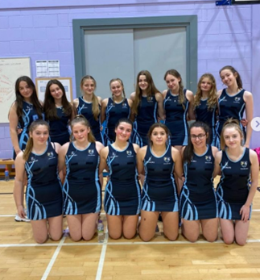
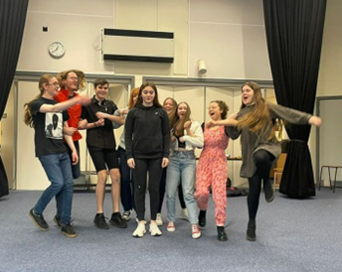
moving well
Universal Support
Extra curricular activities
Targeted Support
Gym buddies
Notes:
11

Slide 12
Attainment
Achievement
Participation
Health and Wellbeing

Slide 13
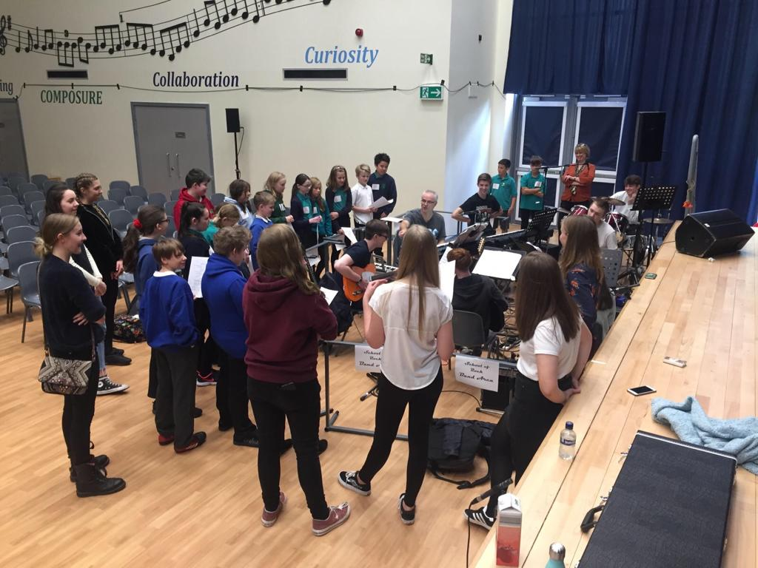
P7-S1 Transition Process
Notes:
Explain process and highlight some ways that you can support your child.
13

Slide 14
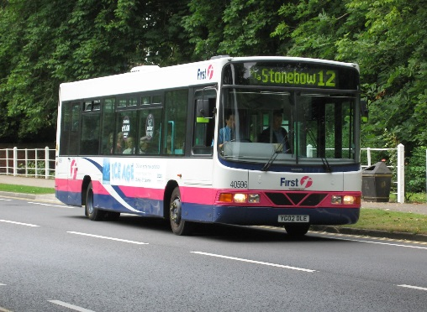
Transition Timeline
Non Cluster Confirmation
Notes:
14

Slide 15
WHA Website
https://www.wallacehall.co.uk/
Handbook
Latest letters and Passport Booklet
Virtual tour

Slide 16
Transition Passport
What can I do as a parent/carer?
Download a copy from our school website and support your child to complete any activities set by your primary school.

Slide 17
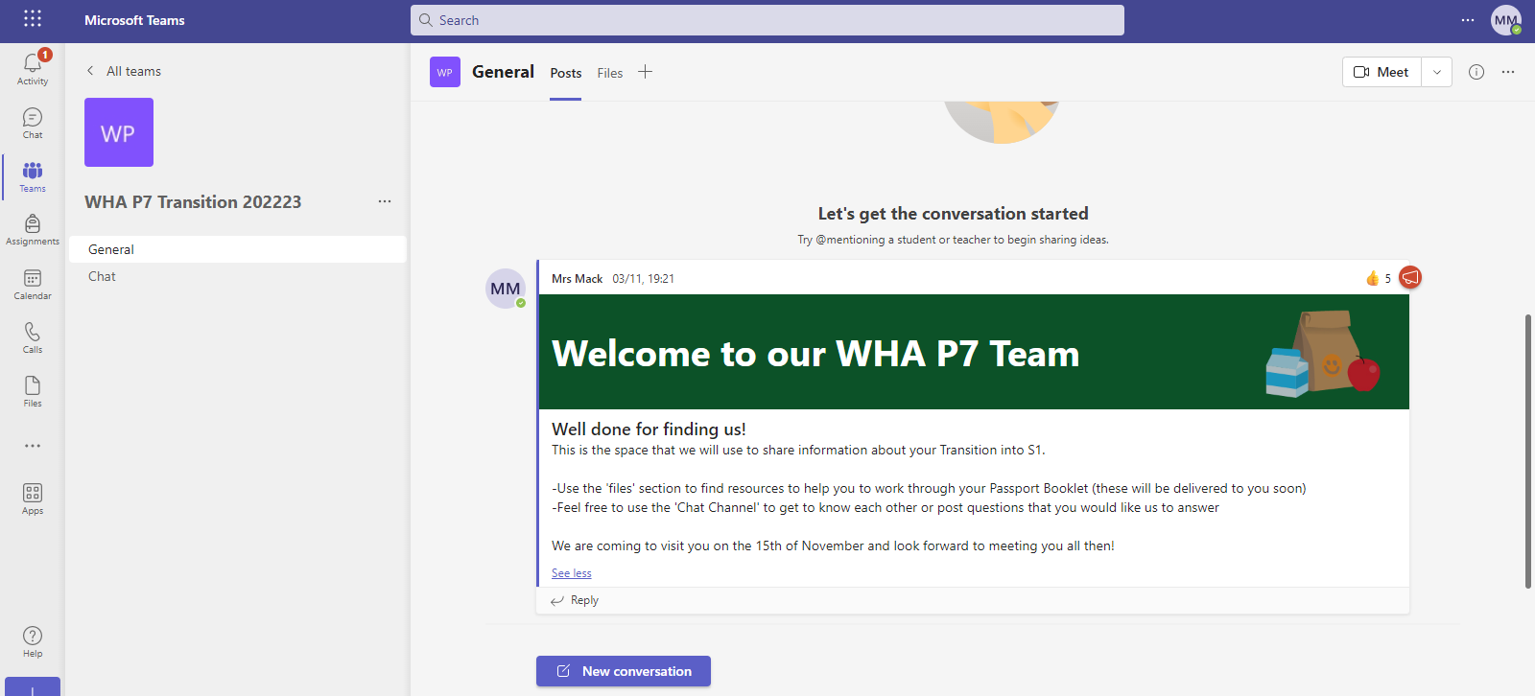
P7 Team
What can I do as a parent/carer?
Support your child to join using the code in your first letter

Slide 18
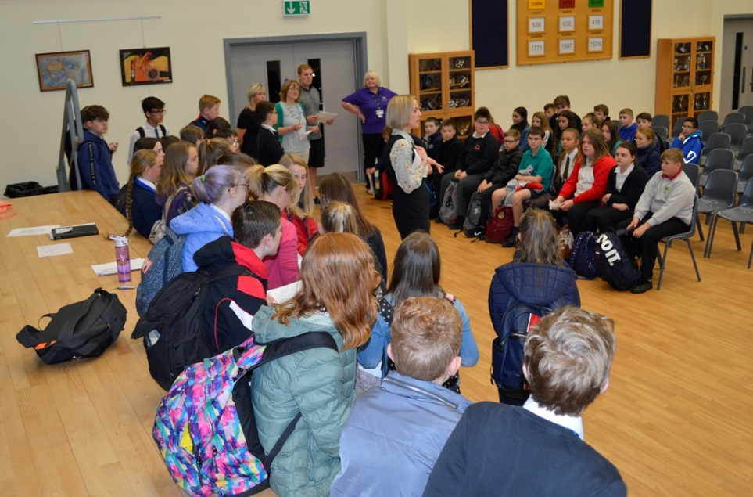
Primary / Secondary teacher meetings
Visits to Primaries
by teaching and support staff
Support staff attend planning meetings
Sharing Information
Pupil Info. Icon
Notes:
Maths/modern languages across cluster increasing to further strengthen continuity in curriculum and help us build learning picture of new S1. After planned meetings go to enhanced. Highlight fact that we confident in doing this effectively for non cluster too-this year we had pupils from an additional 10 primary schools, established relationships and processes ensure smooth transition for all.
18

Slide 19
Enhanced Transition
How does
it work?
Individual pupils identified by primary staff
Transition programme is tailored to individuals needs
What does it
look like?
Individual school tours
Joining S1 classes to experience a lesson
Meeting and working with key staff
Secondary ASN staff visit primaries to work with individuals
Secondary staff attend planned meetings
Talking to the family and the young person
Additional small group transition visits in term 4

Slide 20
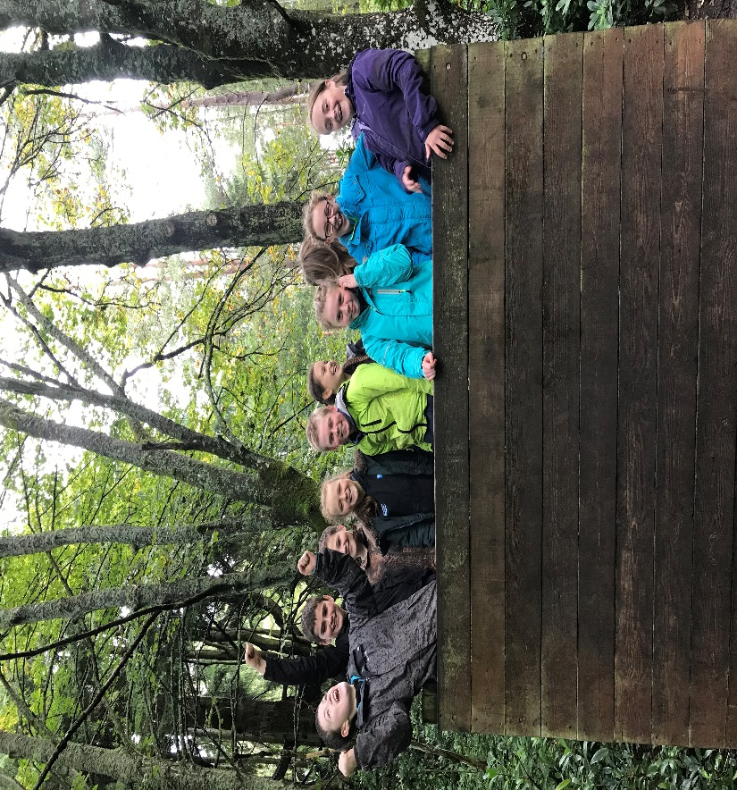
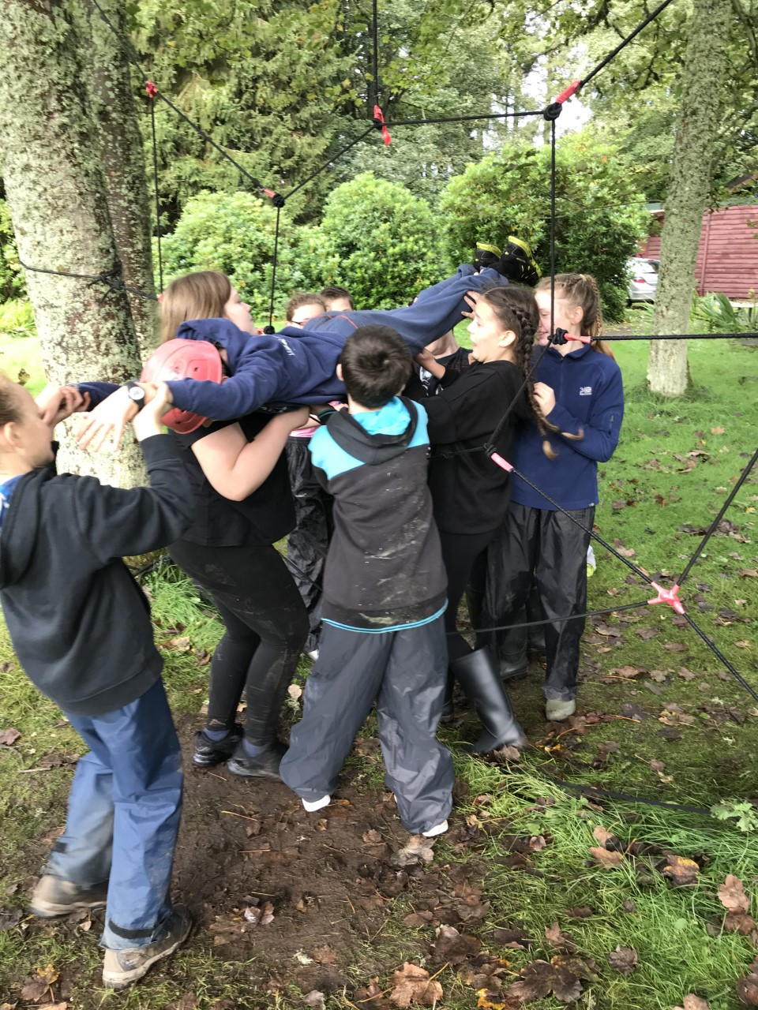
S1 TRANSITION TRIP
Three day residential in September
Outdoor activities to facilitate team building, social and communication skills
Feedback from pupils and staff has been very positive

Slide 21
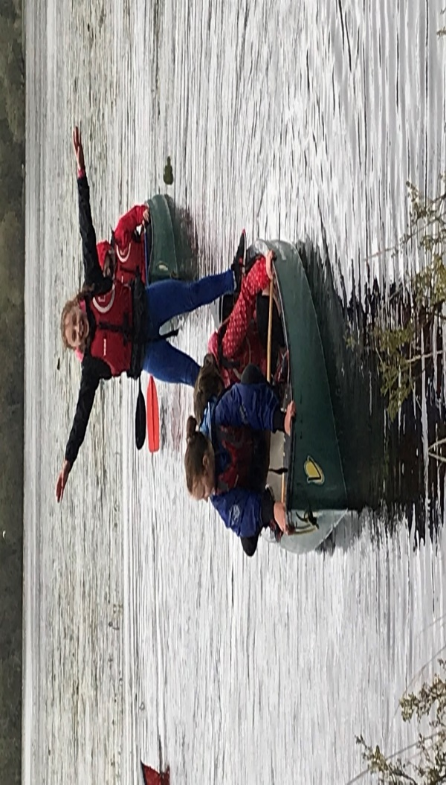
Advice FROM new S1 Pupils
‘You will make friends easier than primary’
‘Be yourself have fun and don’t be scared and try to make new friends from different places :)’
‘You don't need to worry the school is really good and the teachers are really nice and fun.’
‘You might outgrow your friends from primary but don’t worry you will find others who will be your friends. I have already made seven.’
Notes:
Proud of our inclusive culture
21

Slide 22
P7 Information Evening
What happens next?
Notes:
22

